Slide 1
Introduction to SharePoint Branding
getting started
Notes:
This introductory lecture provides an overview for Web designers beginning to work in a SharePoint 2010 environment. There will be a quick review of SharePoint terminology and architecture in which students will be introduced to essential SharePoint design concepts such as site collections, master pages, the Master Page Gallery and the Style Library. The lectures concludes with a discussion which highlights the similarities and differences between Team Sites and Publishing Sites from the perspective of a Web designer who is working on a custom branding project.

Slide 2
Student Background
Languages and syntax you may have used
HTML, XHTML and CSS
ASP.NET Master Pages
JavaScript and jQuery
XML, XSLT and XPath
C# or VB.NET
Design and branding tools you may have used
SharePoint Designer
DreamWeaver
Adobe Photoshop
Microsoft Expression
Visual Studio and ASP.NET

Slide 3
Agenda
SharePoint Branding Overview
SharePoint Architecture
Introduction to SharePoint Designer 2010
Anatomy of a Team Site
Anatomy of a Publishing Portal

Slide 4
Branding
Branding:
The act of building a specific image or identity that people recognize in relation to your company
Website Branding:
Designing elements to give site its look and feel
Notes:
"Branding" is a generic term. It means one thing to a marketing executive and something totally different to a Website designer. However, it usually revolves around building the recognition of a company, organization, product or service through the creation of things that can be seen, read or heard. We all know recognizable images and logos for products like Coca Cola and McDonalds.
Website branding is more specific. It has to do creating or recreating a design that is based on recognizable images and logos into the pages of a Website.

Slide 5
Branding a Website
Designing and implementing the look and feel
Selecting fonts, colors and images
Designing page layout and navigation
Can involve overall site functionality
Steps when planning a large branding project
Create wireframes
Create design comps
Design page layouts using HTML and CSS
Implement design in test site
Move implementation into production
Notes:
Website branding typically involves designing a Website using a set of fonts, colors and images that are recognized as the company's brand. Companies often hire design firms to create a logos for business cards and product packaging as well as for designing their Website. The design artwork is often done using professional design software such as Adobe Photoshop.
The work for a Website branding project often goes further as it involves deciding what content should be displayed on the Website as well the actual layout of the Website's page. The scope of a Website branding project can also include extra functionality including whether the user can register a site member account or submit a request for a sales quote.
A project to brand a Website often involves the following phases:
Creating a black and white wireframe to make a decision about the general page layout and what elements will go on the pages.
Creating design comps so the project stakeholders can argue about and then agree upon colors, fonts, images and general page layout. Design comps are usually created with professional design software and are really just pictures as opposed to real Website implementations.
Creating the mockup page designs using HTML, CSS and JavaScript can be started once a design comp has been selected from a set of candidates.
Once a set of pages have been designed with HTML, CSS and JavaScript, it is time to add them to a test site to implement the required site functionality as a whole.
Once the test site and all its pages have been created and tested, they can be moved into the production site so the site can go live.

Slide 6
Branding for SharePoint
Knowing about general Website branding plus…
Knowing how SharePoint uses master pages
Knowing how SharePoint uses CSS
Knowing how much you can do with Themes
Knowing what is easy versus what is hard
Taking the project budget into consideration
Notes:
To become proficient at branding SharePoint sites, one must have the general Website branding skills discussed on the previous slide. However, one must also learn quite a few things about how things work in SharePoint 2010. First, you have to understand the concepts and syntax of ASP.NET master pages. You have to know how the standard SharePoint master pages have been put together. You also must learn how SharePoint integrates CSS rules into its pages and you have to become familiar with many of the 100s of CSS rules that SharePoint provides out of the box.
Once you begin to get experience with branding SharePoint Websites, you will learn what branding features are easy to implement and which ones are expensive. A good example is the often requested requirement for rounded corners. This is a request that someone not familiar with SharePoint might think it easy and inexpensive to implement. But issues with SharePoint and the Internet Explorer make rounded corners a relatively expensive feature to implement.

Slide 7
SharePoint Editions
SharePoint Foundation is the free version of SharePoint
Supports collaboration, documents and wiki web pages
Sites created as Team sites and Blank sites
SharePoint Server 2010 is licensed version of SharePoint
Includes support for Publishing sites and other features
Better platform for creating branded websites
Notes:
The use of SharePoint Foundation by itself doesn't have licensing costs associated with it. Instead, this product comes for free when you pay for the underlying operating system which is Windows Server 2008 (or later). In a farm that just runs SharePoint Foundation, there is support for creating team sites and creating lists for collaboration such as Contact lists, Announcement lists, Task lists and document libraries.
The use of SharePoint Server 2010 involves both server-side licensing fees as well fees associated with Client Access Licenses (CALs). However, there is a great deal of value-added software in return which provides functionality in areas such as search, document management, business intelligence and Web content management. For Website designers, it is important to take note that the standard edition of SharePoint Server 2010 is what provides support for publishing sites. As you will see, publishing sites provide a great deal of support for many aspects of branding. Therefore, you should always commit to one of the following three assumptions at the start of an SharePoint branding project.
The project will only involve branding publishing sites
The project will only involve branding non-publishing sites (e.g. team sites)
The project will involve branding publishing sites as well as team sites

Slide 8
Agenda
SharePoint Branding Overview
SharePoint Architecture
Introduction to SharePoint Designer 2010
Anatomy of a Team Site
Anatomy of a Publishing Portal

Slide 9
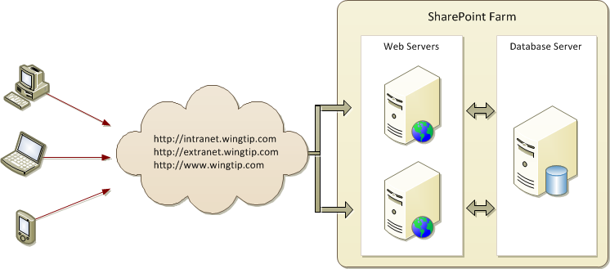
The SharePoint Farm
SharePoint deployment based on a farm
Farm requires Web server(s) and database server
Farm can be single server or multi-server
Each farm has exactly one configuration database
Notes:
A typical SharePoint Farm consists of a database server and one or more Web servers. All user actions such as uploading a document, deleting a list item or customizing a Web Part are tracked by the database server and there is never any need to save anything to the Web server computers. This is also true of all work done using the SharePoint Designer.
SharePoint development is a different story because it involves making changes to front end Web server. For example, SharePoint developers often create templates and components that must be deployed to the Web server. This makes SharePoint development more costly and more risky. However, SharePoint development is also an approach that allows you to create SharePoint solutions that are reusable across site collections and across farms.
While this course is not deeply focused on SharePoint development, all the principles you will learn about creating master pages and CSS files can be applied to SharePoint development. For example, you can create custom master pages, CSS files and site pages in a test site using SharePoint Designer. Once you have a branded site that looks good, you can move your efforts into Visual Studio project by creating template files for your master pages, CSS files and site pages. This approach allows you to leverage the productivity of SharePoint Designer and also to create branding solutions that can be reused, versioned and deployed instantly in production farms.

Slide 10
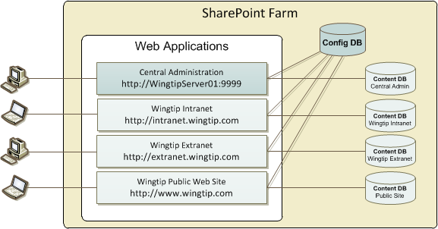
Web Applications
Web Applications provide HTTP entry points
Web Applications based on IIS Web sites
Web Application defines one or more URL spaces
Web Application security configured independently
Notes:
SharePoint 2010 leverages IIS7 to provide an entry point for incoming HTTP requests and to manage worker processes on the Web server. Each Web application is built on top of one or more IIS Websites. The Web application is configured to accept HTTP request targeting one or more domain names. It is the job of the Web application to figure out the target site for each incoming request and to query a special database known as the content database to retrieve the content that is needed to process the requested page.
The Web application is important when it comes to security because its authentication settings can be configure independently of other Web applications. For example, the Web application which serves up collaboration sites for employees at http://intranet.wingtip.com can be configured to only support integrated Windows authentication and to disallow anonymous access. The Web application for the Wingtip public Web site can be configured to support anonymous access and to allow other forms of authentication such a forms-based authentication (FBA) or authentication using Windows Live ID.

Slide 11
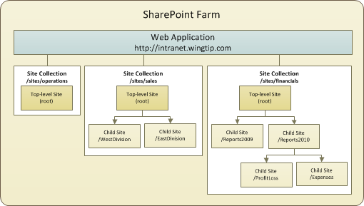
Site Collections and Sites
Sites are partitioned using Site Collections
Site collection is scope for administrative privileges
Site collection always contains top-level site
Site collection may contain hierarchy of child sites
Notes:
In SharePoint 2010, every site lives in a container known as a site collection. Every site collection must have a top-level site. A site collection can optionally have child sites below arraigned in a hierarchy.
Each site collection represents an island with respect to security. There is nothing a site administrator can do in one site collection that will ever effect the configuration of permission in another site collection. This constrain is by design in the product.
The concept of the site collection is important when working on a SharePoint branding project. Most of your branding efforts will be created inside a specific site collection. However, it is often possible to create master pages and CSS files in the top-level site and to leverage these reusable resources in child sites throughout that site collection. However, trying to create a branding asset such as a master page or CSS file that is used across site collection is hard and often impractical to do with SharePoint Designer alone. To achieve true reuse of SharePoint branding assets across site collection boundaries requires SharePoint development.

Slide 12
A SharePoint Site is a Collection of Pages
All pages share the same look and feel
HTML page layout defined by common Master Page
Page formatting defined by common CSS files
Client-side behaviors defined by JavaScript files
Pages within site can be split into two categories
Site Pages exist within the content DB for a site
Application Pages only exist on file system of WFE
Notes:
All pages within a SharePoint site have the same look and feel. The common look and feel is implemented in a master page and leveraged across all the pages that link to it.
It is also important for you to distinguish between site pages and application pages. Site pages are tracked on a site by site basis within the content database. Site pages also can be added, customized and deleted by users. Application pages are fundementally different than site pages because they are deployed directly to the file system of the Web server as text files with an .aspx extension. Note that application pages do not support any form of user customization.

Slide 13
Site Pages Versus Application Pages
Site pages are tracked inside content database
They may or may not be ghosted (uncustomized)
They support customization via Web Parts
They support customization via SharePoint Designer
Application pages deployed on Web server
Served up out of _layouts directory
They do not support customization or Web Parts
They are parsed/compiled as classic ASP.NET pages
They cannot be edited or seen in SharePoint Designer
Notes:
It is important you understand why site pages are fundamentally different than application pages. These two lists summarize the most important differences.
Site pages:
By default site pages are ghosted which means they are rendered using a page template stored on the file system of the Web server. The content database tracks the URL to the page and the path to the page template.
Site pages can be customized using Web Parts. This does not require SharePoint to unghost the page from the underlying site page template..
The content of a site pages can be customized with SharePoint Designer. This type of customization requires SharePoint to unghost the page and store the unique page contents in the content database.
Application pages:
Are deployed in the _layouts directory of a Web application.
There is one version of an application page scoped at the farm level.
Are compiled into a single DLL and loaded into memory once
Can never be seen or edited by SharePoint Designer

Slide 14
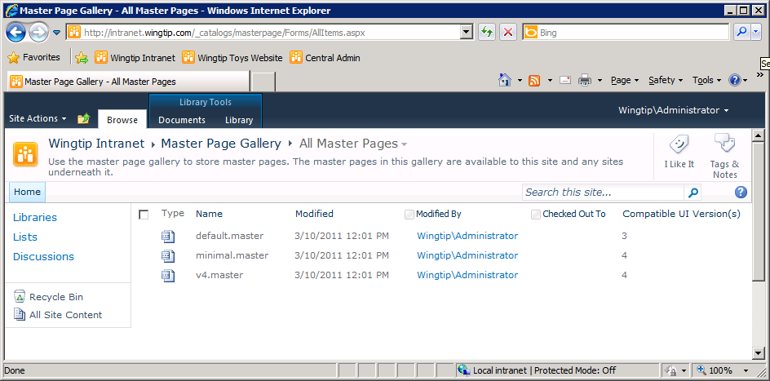
The Master Page Gallery
Each site has a Master Page Gallery
v4.master used for page layout in SharePoint 2010
minimal.master used in a few sites (e.g. Search Center)
default.master used to create SharePoint 2007 UI
Notes:
Every SharePoint 2010 site has a special hidden document library known as the Master Page Gallery (MPG). When a site is created, SharePoint creates the MPG and adds three standard Master Pages that initially exist in a ghosted state.
v4.master: The main Master Page in SharePoint 2010 which gives a team site its out-of-the-box look and feel.
minimal.master: a less commonly used SharePoint 2010 master page that does not have the usual chrome such a banner or navigation elements.
default.master: the Master Page used for the standard look and feel of SharePoint 2007 sites. This Master Page is primarily used to retain the SharePoint 2007 user interface for some period of time on sites that have been migrated from a SharePoint 2007 farm to a SharePoint 2010 farm. This functionality is known as Visual Upgrade.

Slide 15
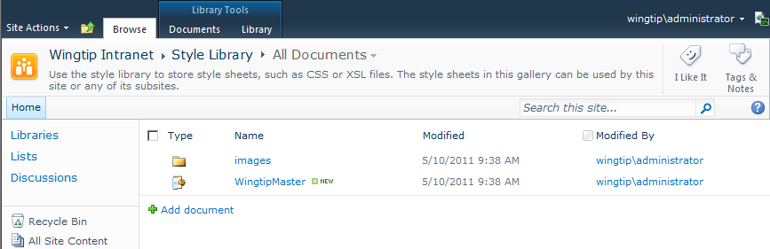
The Style Library
SharePoint automatically creates Style Library
Document library created in every top-level site
Used to store branding files such as CSS and images
Only added to publishing sites in SharePoint 2007
Added to every new site collection in SharePoint 2010
Notes:
The Style Library is a document library that is automatically added to the top-level site of every new SharePoint 2010 site collection. It is commonly used to store CSS files and image files such as GIF, JPG and PNG files. SharePoint Server 2010 also uses the Style Library in publishing sites to store CSS files, images and XSLT files for components such as the Content Query Web Part (CQWP).
In SharePoint 2007, the Style Library only existed in site collections with publishing sites. In SharePoint 2010, the Style Library is now created in every site collection. The Style Library is important in branding because it becomes one of the best placed to deploy custom CSS files and image files.

Slide 16
DEMO
Inspecting the Master Page Gallery and the Style Library

Slide 17
Agenda
SharePoint Branding Overview
SharePoint Architecture
Introduction to SharePoint Designer 2010
Anatomy of a Team Site
Anatomy of a Publishing Portal

Slide 18
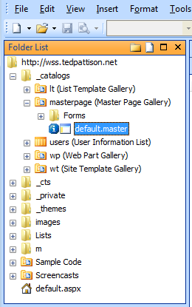
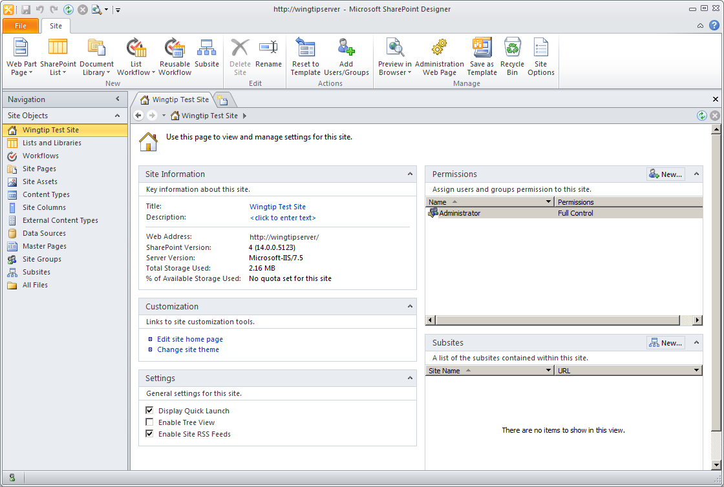
SharePoint Designer 2010 (SPD)
SPD is a site-level customization tool
SPD 2010 significantly improved over SPD 2007
SPD 2010 is not compatible w/ SharePoint 2007 sites
SPD 2007
SPD 2010
New UI focused on SP Objects
Notes:
The version of SharePoint Designer created for SharePoint 2007 had quite a few painful problems and gained a reputation as a buggy piece of software to be avoided especially in production farms.
Microsoft worked hard to make the newer version of SharePoint Designer easier to use and more reliable. SharePoint Designer 2010 has gone through many significant improvements:
SharePoint objects such as lists and workflow associations are seen as first class objects in the new UI.
Each SharePoint object has a summary page.
The new workflow designer is much more powerful.
You can create reusable workflows – this was a big problem in SPD 2007.
It doesn't mess up the HTML in your pages as much as it used to.
One important point to note is that SharePoint Designer 2010 is not backwards compatible meaning it cannot be used to customize sites in a SharePoint 2007 farm.

Slide 19
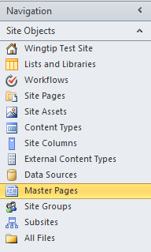
SPD Navigation Pane
Navigation pane is a quick launch mechanism
Provides navigation to most common components
Security trimmed based on current user permissions
Notes:
Navigation Pane serves as a “Quick Launch” within SharePoint Designer. Site components such as lists, libraries, workflows, content types etc. can all be accessed directly through links in the navigation pane.
Note that the Navigation Page will display and/or hide specific sections depending on the permissions of the current user. For example, one user might see more sections in the Navigation Pane than another due to a greater level of permissions. Also, the type of site which is opened has an effect and what shows in the Navigation Pane. For example, you might see a Page Layouts section when you open a publishing site but you will never see that section after opening a team site.

Slide 20
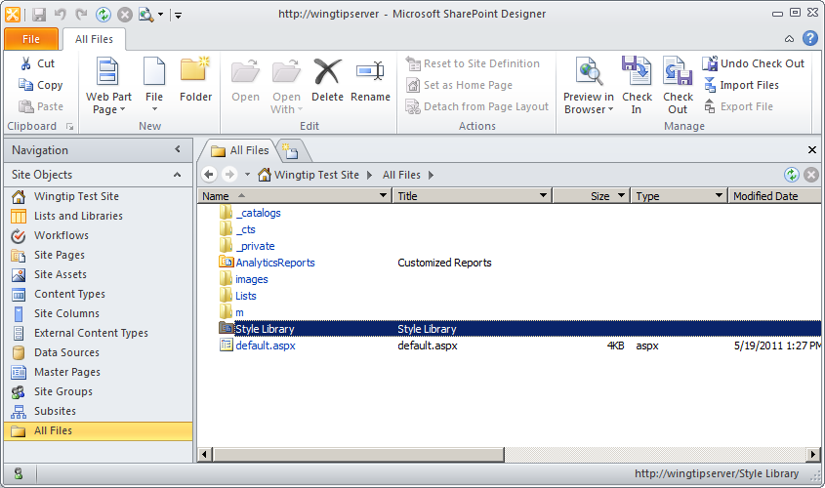
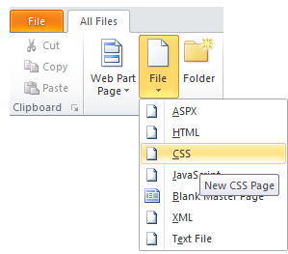
All Files View
All Files view shows virtual file system of site
Allows access to files not available in navigation pane
Provides ability to edit pages and add new pages
You can drag-and-drop files from Windows Explorer
Add New Files using File menu
Notes:
The All Files view is the Explorer type view that lets you access every file within a site.
The All Files view provides a behind-the-scenes look of the structure of folders and files that make up the virtual file system of a SharePoint site.
The All Files view is important to SharePoint branding work because it provides a way to view, add, edit and delete files in locations that do not have a node in the Site Objects section such as the Style Library and the root folder of a site.
Make sure you observe the File menu in the New section group of the Ribbon. Once you have selected a folder in the All Items view, this ribbon command makes it easy to add a new file such as a site page, a CSS file or a JavaScript file.
Note that you can drag-and-drop files from the Windows Explorer on top of the All Files view and the SharePoint Designer will copy the files into the content database at the proper location. This can be extremely helpful when you need to upload 100 GIF files to a folder inside the Style Library.

Slide 21

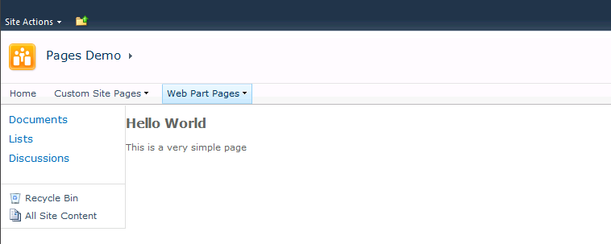
'Hello World' Content for a Site Page
Notes:
This code snippet shows a sample of a simple site page. If you create a new site page such as Hello.aspx at the root of a site using SharePoint Designer, you can add this text to get the page to display like the one in the screenshot above.
Note this example has a MasterPageFile attribute of ~masterurl/default.master. Do not be confused into thinking that the page is using default.master as its master page. Instead, ~masterurl/default.master is a dynamic token which instructs SharePoint to use the master page which has been assigned as the master page for the site. By default, a page with a MasterPageFile attribute value of ~masterurl/default.master will use v4.master as its master page. However, the master page for the site can be modify which will automatically direct a page like this to a different master page. This will be discussed in more detail in the following lectures.
This example also demonstrate overriding the placeholder named PlaceHolderMain. This allows your page to add content into the main body section of the page. Before long you will learn about many more placeholders in addition to PlaceHolderMain.

Slide 22
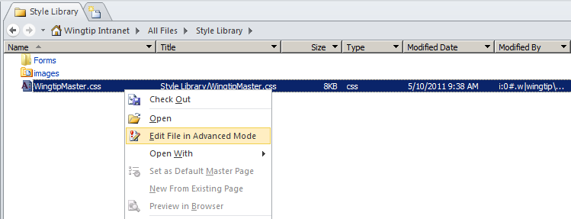
Editing Files in SharePoint Designer
Choose Edit File in Advanced Mode
This provides ability to edit all portions of a site page
Notes:
SharePoint Designer provides a protected mode which is the default mode for editing site pages. When you open a site page in this mode, SharePoint Designer allows you to edit content inside of existing placeholders, but it prevents you from adding, removing and modify the placeholders themselves.
When you want to add, delete or modify placeholders in a site page, you must open the site page in Advance Edit Mode. This will be a requirement for most of the work you will do with site pages. Note that advanced mode really only applies to site pages (.aspx files) and does not apply to other types of files such as CSS files, XSLT files and JavaScript files.

Slide 23
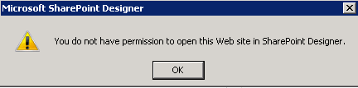
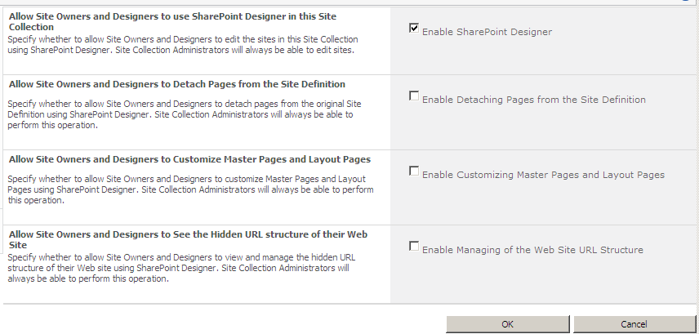
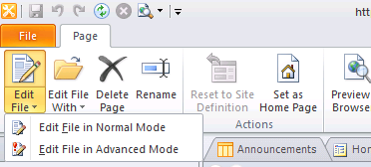
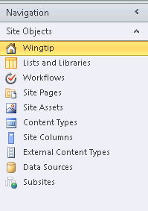
Restricting SharePoint Designer
Revoke permissions as needed from Site Owners and Designers
Notes:
SharePoint Designer is a powerful application. If not used properly, it can have adverse affects on the site.
Site collection administrators can decide to turn off certain features of SPD for Site Owners and Designers as shown in the image on the slide. All objects in SPD are context sensitive. Thus, if certain permissions are revoked, the appropriate objects will ‘turn off’ and become unavailable from the SPD interface (ex: Master Pages, All Files, Advanced editing mode etc.).
Further, SharePoint farm administrators can limit SPD’s use within a Web application from Central Administration. These settings trump any site collection administrator’s selections (if blocks are used).

Slide 24
DEMO
Getting Started with SharePoint Designer 2010

Slide 25
Agenda
SharePoint Branding Overview
SharePoint Architecture
Introduction to SharePoint Designer 2010
Anatomy of a Team Site
Anatomy of a Publishing Portal

Slide 26
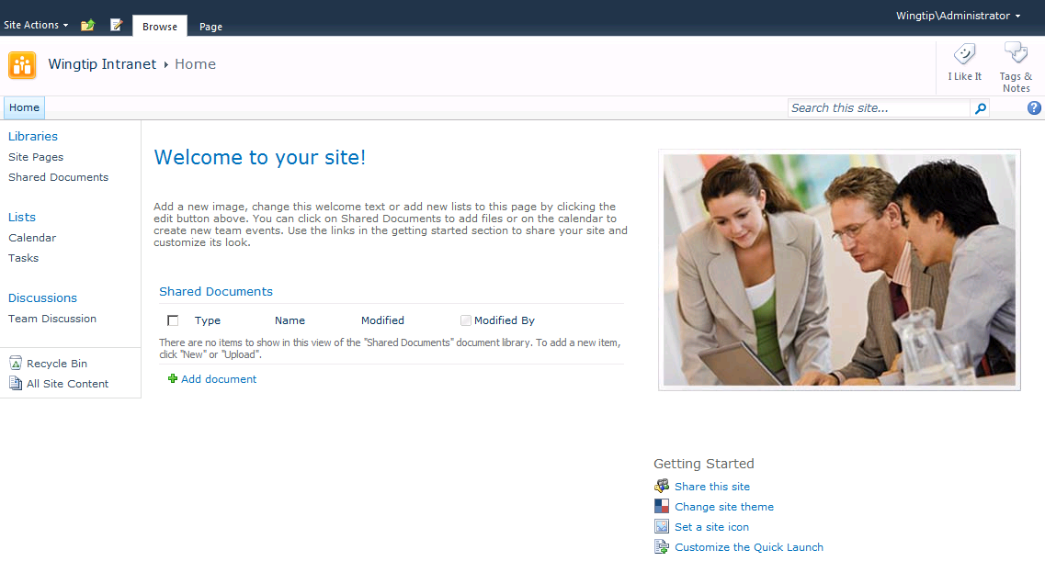
Team Sites
Team sites supported by SharePoint Foundation
They facilitate collaboration on lists and documents
They provide new enhanced support for wiki pages
Notes:
SharePoint Foundation provides support for team sites. This means a team site can be created in either a SharePoint Foundation farm or a SharePoint Server 2010 farm. Team sites support a set of collaboration list types such as Contacts lists, Announcements lists, Task lists, Events lists and document libraries.
In SharePoint 2010, team sites were enhanced to wiki page functionality. Every team sites is created with a wiki page library named Site Pages and a wiki home page at the URL of /SitePages/Home.aspx.

Slide 27
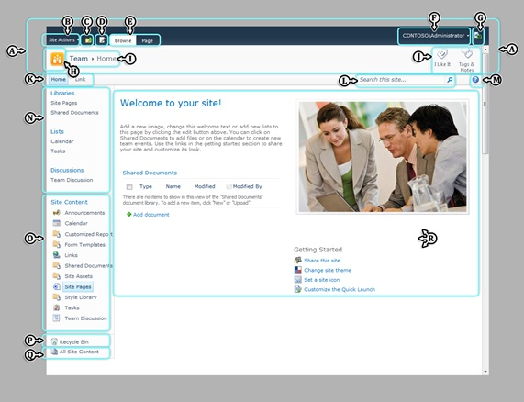
SharePoint 2010 Page Elements
A | Server ribbon
B | Site Actions
C | Global breadcrumbs control
D | Page State Action button
E | Ribbon contextual tabs
F | Welcome menu
G | Developer Dashboard button
H | Title logo
I | Breadcrumb
J | Social buttons
K | Global navigation
L | Search area
M | Help button
N | Quick Launch
O | Tree View
P | Recycle Bin
Q | All Site Content
R | Body area
Notes:
A SharePoint 2010 Team Site includes a standard set of page elements that are listed in the screenshot above. When you begin a branding project you should go through this list of standard page elements and decide which ones are appropriate for the site you are designing.
Note that several standard page elements are more appropriate for collaboration sites where all users are authenticated and much less appropriate for publically-facing Internet sites that must support anonymous access. Here is a list of page elements that are commonly hidden or removed from pages when displaying them to users who are accessing the site with anonymous access.
Server ribbon
Site Actions
Social buttons
Help button
Recycle bin
All Site Content

Slide 28
Lists Added By SharePoint
Added to every top-level site
Style Library (used to store images and CSS files)
Added to every Team site
Site Pages (standard Wiki Library)
Site Assets (standard document library for photos, videos, etc.)
Notes:
Remember the Style Library is added to every top-level site whether it is a team site or not. Team Sites have a feature enabled that creates the wiki page library named Site Pages and a document library named Site Assets.
The wiki page library provides the home page (SitePages/home.aspx) for the site as well as any of wiki page that contributors of the site want to add. In addition to the home page, a wiki page library is always created with a second wiki page which is named How To Use This Library.aspx. This page provides a quick tutorial on the symbols to use to create links when editing wiki pages.

Slide 29
DEMO
Working with Wiki Pages in a Team Site

Slide 30
Agenda
SharePoint Branding Overview
SharePoint Architecture
Introduction to SharePoint Designer 2010
Anatomy of a Team Site
Anatomy of a Publishing Portal

Slide 31
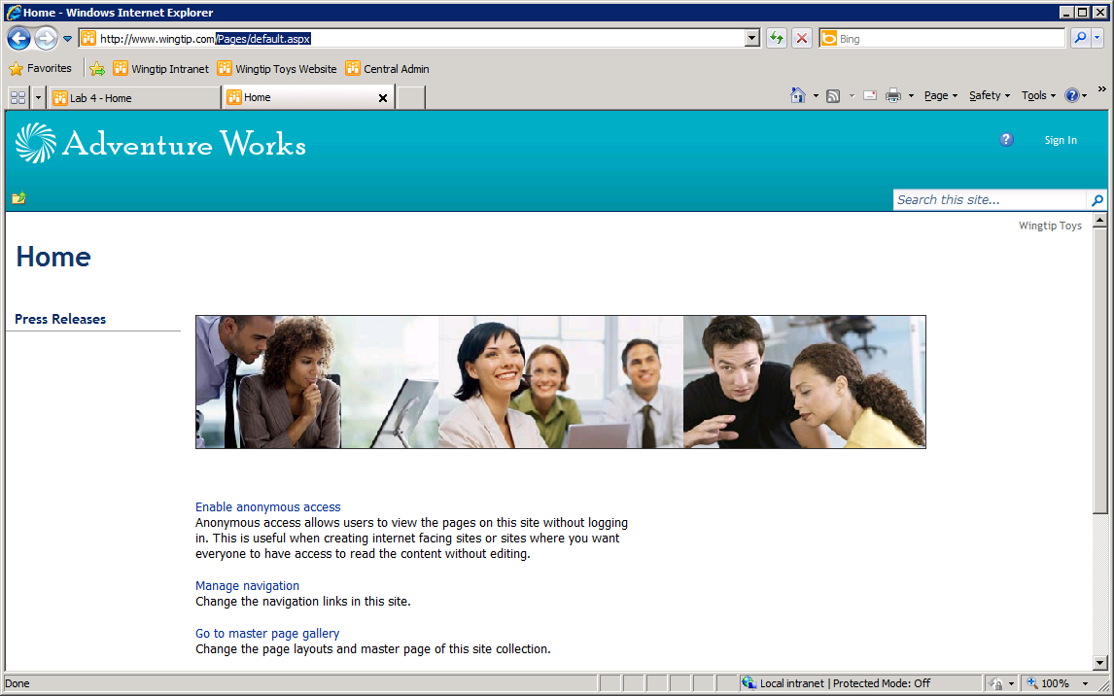
SharePoint Server 2010 Support for WCM
SharePoint Server 2010 supports WCM
WCM = Web Content Management
SharePoint WCM strategy based on Publishing sites
Top site must be created using publishing site template
Notes:
SharePoint Server 2010 standard edition provides SharePoint's WCM functionality through publishing sites. Publishing sites provide a significant amount of extra functionality beyond what is available in team site.
To use the WCM functionality correctly, you must create a site collection with a publishing site as the top-level site. Once the site collection has been created with a publishing site at the root, it is possible to create child sites using both publishing sites and team sites. However, adding publishing sites to a site collection with a team site at the root is not a supported scenario and should be avoided.

Slide 32
Publishing Sites
Publishing sites built around publishing pages
Publishing pages added to Pages document library
Publishing pages created/edited by content authors
Publishing pages approved by content managers
Publishing sites provide branding functionality
Support to upload and apply custom master pages
Support to upload and apply custom CSS files
Support to customize navigation
Notes:
Every publishing sites contains a document library named Pages which contains a special type of site page known as a publishing page. Publishing pages provide a customized editing experience for content authors as well as a display view for site readers and anonymous users. Publishing pages also have a built-in approval process. When a content author has created a new publishing page and finished editing, it is still not visible to the site's readers. Instead, the publishing page must be checked in as a major version (e.g. version 1.0) and then approved by a content manager who has approval permissions. At that point the publishing page is finally visible to the site's readers.
Publishing sites provide extra branding functionality beyond what is available in team sites including the ability to upload and integrate master pages and CSS files into a site using the browser. Publishing sites also provide a different navigation scheme which provides more flexibility and customization options than the navigation scheme available in a team site.

Slide 33
Summary
SharePoint Branding Overview
SharePoint Architecture
Introduction to SharePoint Designer 2010
Anatomy of a Team Site
Anatomy of a Publishing Portal

Slide 34
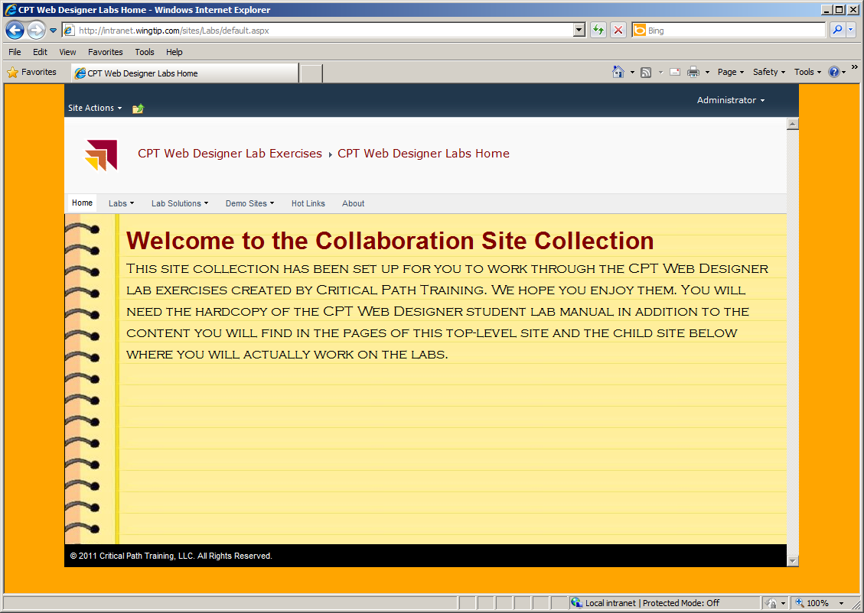
About the Lab Exercises
Notes:
The labs in the course have been designed so you will do you work in two different site collections. The first site collection is the Collaboration Site Collection which is made up of team sites and blank sites. There is a branded top-level site and a child site for each lab where you will do your work. Also note that each lab has a separate child site which contains the lab solution. These solution labs will allow you to see what the finished site should look like. You should also feel free to open up these solution labs with the SharePoint Designer if you want to see a solution for the HTML, CSS, XSLT and JavaScript you are asked to write in the lab exercises.
Some lab exercises will be done in the Publishing Site Collection which is a standard site collection created using the Publishing Portal site template included with SharePoint Server 2010 standard edition. These labs will take you through the process of adding child sites, configuring navigation, integrating master pages and designing page layouts.

